Slide 1
Sports Analytics
By Varun Nair

Slide 2

Project Idea
Project Idea is inspired from movie MoneyBall
https://en.wikipedia.org/wiki/Moneyball_(film)

Slide 3
Sports analytics is a fast-growing field that is moving far beyond the innovations in recruiting and tactics. Teams in basketball, football, hockey, cricket, kabaddi , soccer etc have followed baseball in building analytics departments to support myriad aspects of decision-making on and off the field. To explore recent trends in sports analytics from a practical point of view, offering skills and ideas to create analytics of potential value to professional sports enterprises.

Slide 4
Develop an interactive analytic tool with realistic prediction and stats on an enterprise and user level.
List of questions your model/problem are designed to answer:
most recent trends
profits
investments
best place for promotions
most popular player
players stats (health and game/track record)
Team's performance history
2 teams game play strategies
Video analysis for discrepancy
Text and social media analysis
Pattern analysis

Slide 5
Details of the model , important findings, expecting observations and outcome:
Analyzing the data for creating an graphical story
Compare and contrast
De-constructing data
Making own graph
Make a deeper analysis
Map the numbers

Slide 6
Data set source:
http://www.muniversity.mobi/mod/page/view.php?id=8371
http://www.muniversity.mobi/mod/page/view.php?id=8372
Soft ware: Hadoop, R, Python, SAS, Stata, Matlab, etc
References:
http://learning.blogs.nytimes.com/2015/10/07/playing-smart-with-data-using-sports-analytics-to-teach-math/?_r=1
http://northyardanalytics.com/ECON-GB.2162.30_Sports_Analytics_in_Practice_Syllabus.pdf
http://www.sas.com/content/dam/SAS/en_us/doc/whitepaper2/iia-analytics-in-sports-106993.pdf

Slide 7
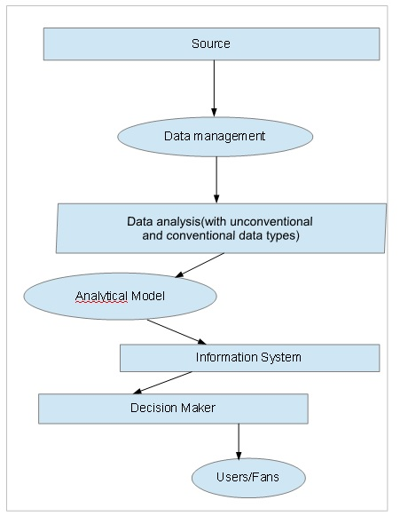
Technical architecture

